Slide 1
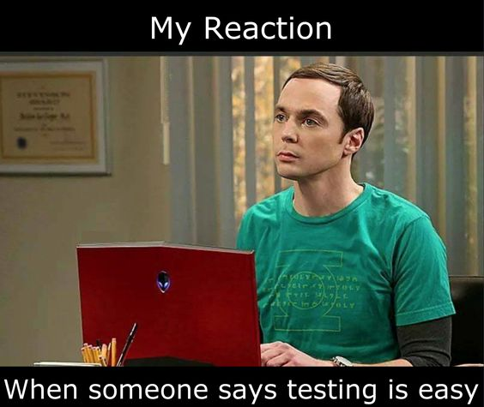
Introduction to
Unit Tests

Slide 2
Agenda
Motivation
Case study: NUnit
Testing
Basic parts of a unit tests
What does a unit test look like?

Slide 3
Manually test
class Program
{
static void Main(string[] args)
{
// Declare the unit-under-test
var uut = new Calculator();
// Test Add()
Console.WriteLine("Add({0}, {1}) = {2}", 3.5, 2.5, uut.Add(3.5, 2.5));
Console.WriteLine("Add({0}, {1}) = {2}", -3.5, 2.5, uut.Add(-3.5, 2.5));
Console.WriteLine("Add({0}, {1}) = {2}", -3.5, -2.5, uut.Add(-3.5, -2.5));
// Test Subtract()
Console.WriteLine("Subtract({0}, {1}) = {2}", 3.5, 2.5, uut.Subtract(3.5, 2.5));
Console.WriteLine("Subtract({0}, {1}) = {2}", -3.5, 2.5, uut.Subtract(-3.5, 2.5));
Console.WriteLine("Subtract({0}, {1}) = {2}", -3.5, -2.5, uut.Subtract(-3.5, -2.5));
// Test Multiply()
Console.WriteLine("Multiply({0}, {1}) = {2}", 3.5, 2.5, uut.Multiply(3.5, 2.5));
Console.WriteLine("Multiply({0}, {1}) = {2}", -3.5, 2.5, uut.Multiply(-3.5, 2.5));
Console.WriteLine("Multiply({0}, {1}) = {2}", -3.5, -2.5, uut.Multiply(-3.5, -2.5));
// Test Power()
Console.WriteLine("Power({0}, {1}) = {2}", 2.0, 3.0, uut.Power(2.0, 3.0));
Console.WriteLine("Power({0}, {1}) = {2}", -2.0, 3.0, uut.Power(-2.0, 3.0));
Console.WriteLine("Power({0}, {1}) = {2}", -2.0, -3.0, uut.Power(-2.0, -3.0));
}
}
public class Calculator {
public double Add(double a, double b) {
return a + b;
}
public double Subtract(double a, double b) {
return a - b;
}
public double Multiply(double a, double b) {
return a * b;
}
public double Power(double a, double b) {
return Math.Pow(a,b);
}
}

Slide 4
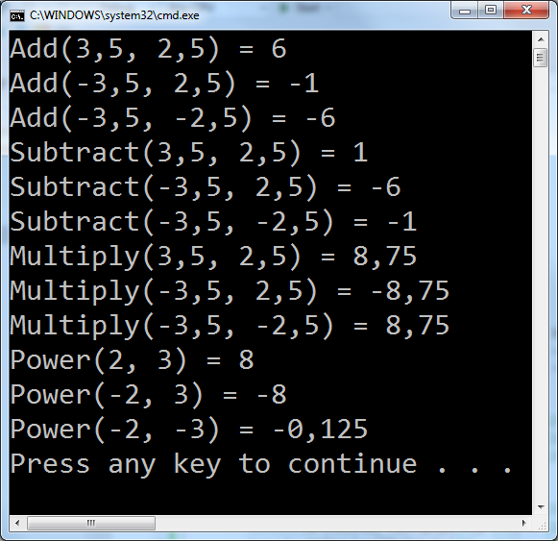
Validate result?

Slide 5


Slide 6


A unit tests
Unit-under-test
(UUT)
Expected result?
Input
Scenario
Output
Icons: FrICONiX.com

Slide 7
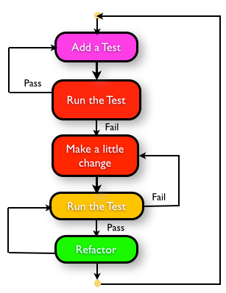
How to plan and execute test
Define a scenario
Write the [TestCase]
Run the test
Implement the code
Repeat

Slide 8
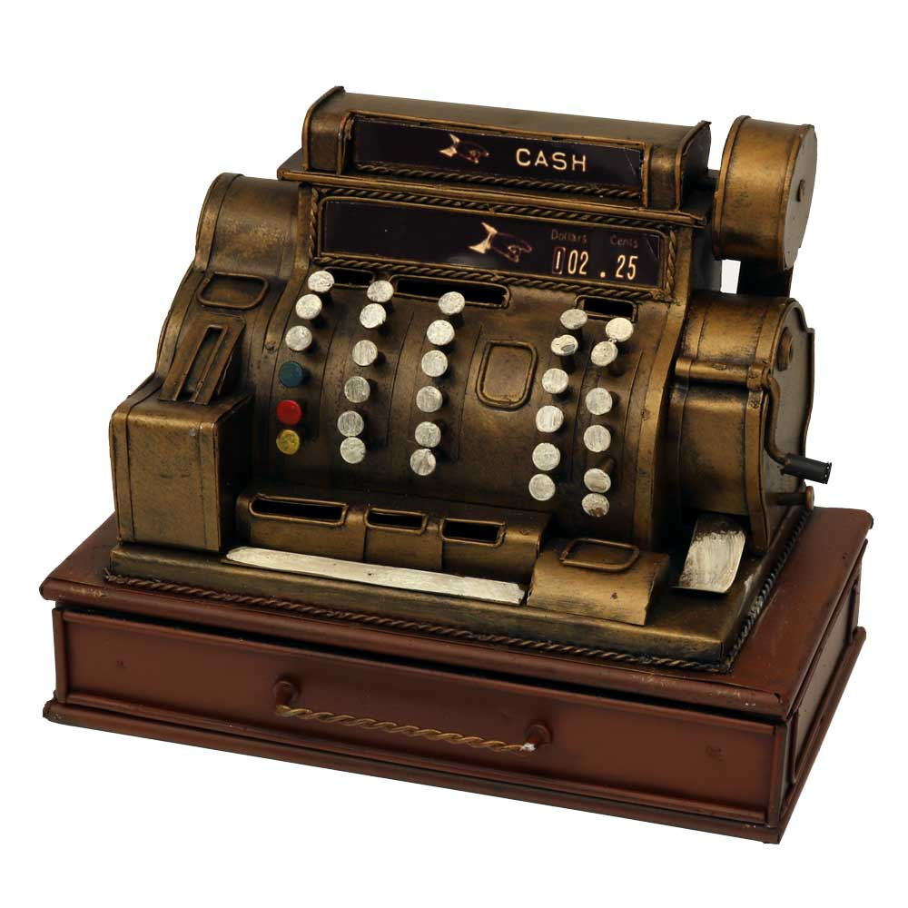
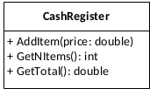
Demo: A cash register
We will implement and test a class CashRegister (UUT)

Slide 9
Demo: A cash register
We will implement and test a class CashRegister
Your turn: What test cases do we need for each of the class’ methods?

Slide 10
Demo: A cash register
We will implement and test a class CashRegister
Your turn: What test cases do we need for each of the class’ methods?
What is the scenario?
What is the test input?
What is the expected result?

Slide 11
Test also gives...
specifications built into the program

Slide 12
Test also gives...
specifications built into the program
confidence in code

Slide 13
Test also gives...
specifications built into the program
confidence in code
early error finding

Slide 14
Test also gives...
specifications built into the program
confidence in code
early error finding
decoupled system

Slide 15
Test also gives...
specifications built into the program
confidence in code
early error finding
decoupled system
better design

Slide 16
Your turn
For around 30 minutes do
Do ‘Exercise 1: Plan your tests’
Continue to ‘Exercise 2: Prepare workspace’ after complete Exercise 1.

Slide 17


Slide 18
Test framework
Gives:
Support for automation
Easy setup and removal
Good assertion constructs
Detailed test reports
Nice IDE integration
Testing styles

Slide 19
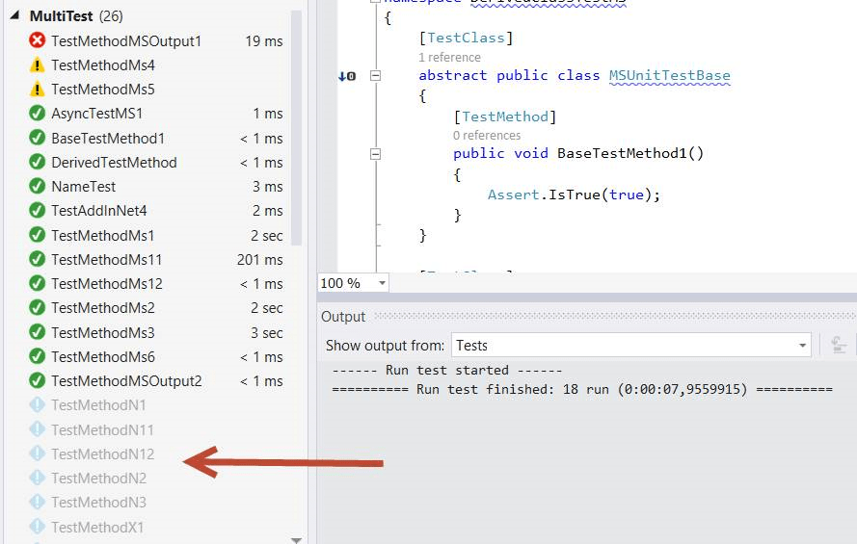
Automation / test report

Slide 20
Nunit example
[TestFixture]
public class UnitTest1 {
Calculator uut;
[Setup]
public void Setup() {
uut = new Calculator();
}
[Test]
public void Test_AddMethod() {
double res = uut.Add(3.5, 2.5);
Assert.AreEqual(res, 6);
}
…
}

Slide 21
NUnit assertion - constraints
Constraint-based assert model
Assert.That(uut.Count, Is.EqualTo(10));
Actual state
Constraint with expected state
More constraints https://nunit.org/docs/2.5/constraintModel.html

Slide 22
NUnit assertion - constraints
Constraint-based assert model
Assert.That(uut.Count, Is.EqualTo(10));
Actual state
Constraint with expected state
Other constraints examples - many more exists
Assert.That(uut.Count, Is.GreaterThan(3));
Assert.That(myString, Is.EqualTo("Hello"));
Assert.That(array, Has.Exactly(3).LessThan(100));
More constraints https://nunit.org/docs/2.5/constraintModel.html

Slide 23
Test framework
Assertions Different ways to compare expected and actual test results in a readable way

Slide 24
Test framework
Assertions Different ways to compare expected and actual test results in a readable way
Test case Each test case - tests one specific, isolated aspect of the unit-under-test

Slide 25
Test framework
Assertions Different ways to compare expected and actual test results in a readable way
Test case Each test case - tests one specific, isolated aspect of the unit-under-test
Test fixture Collects test cases and helps with setup, teardown, etc.

Slide 26
Test framework
Assertions Different ways to compare expected and actual test results in a readable way
Test case Each test case - tests one specific, isolated aspect of the unit-under-test
Test fixture Collects test cases and helps with setup, teardown, etc.
Test runner Runs the tests and reports the result

Slide 27
Test framework
Assertions Different ways to compare expected and actual test results in a readable way
Test case Each test case - tests one specific, isolated aspect of the unit-under-test
Test fixture Collects test cases and helps with setup, teardown, etc.
Test runner Runs the tests and reports the result
Test reports Results of the tests run

Slide 28
Demo: A cash register
Let us implement the CashRegister and TestFixture

Slide 29
Your turn
Continue with exercises
Note: We summarize at the end of the lecture

Slide 30
Testing
and Pitfalls

Slide 31
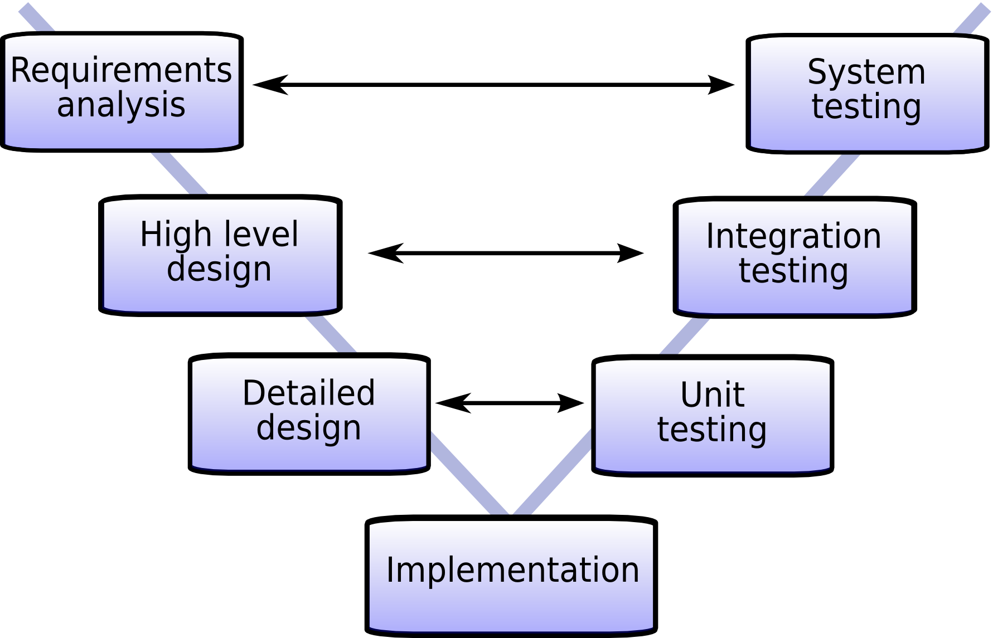

Slide 32
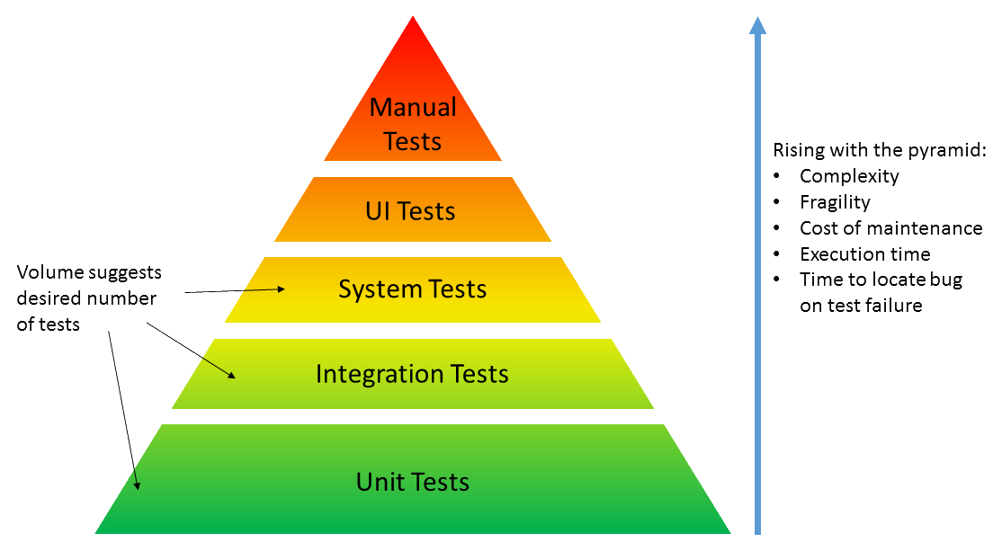
Why test? Why unit test?
Notes:
Speed
Security
Design

Slide 33
Pitfalls
The true unit test contains information about the design and behavior of UUT (Unit-under-test)
Do not make any assumptions about other parts

Slide 34
Pitfalls
The true unit test contains information about the design and behavior of UUT (Unit-under-test)
Do not make any assumptions about other parts
Integration-test do not tell anything about how the code base is broken down into units
Make assumptions about the whole system's behavior

Slide 35
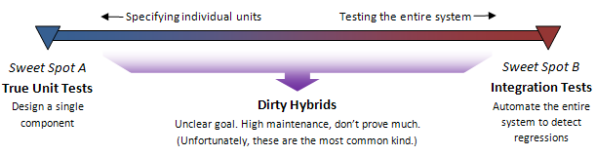
Pitfalls
The true unit test contains information about the design and behavior of UUT (Unit-under-test)
Do not make any assumptions about other parts
Integration-test do not tell anything about how the code base is broken down into units
Make assumptions about the whole system's behavior
In between
Small changes break unrelated test
Tests break - but the system works as “expected”

Slide 37
Reference
TDD: agilefaqs.com/services/training/test-driven-development
Dancing man: https://giphy.com

